Slide 1


Hyperledger Fabric Chaincode

Slide 2


Learning Objectives
By the end of this lesson, you will be able to:
Demonstrate the use of Chaincode
Illustrate the lifecycle of Chaincode as well as the steps involved
Model Chaincode using the Java Library Learn how to develop and deploy Chaincode

Slide 3

Chaincode
Chaincode, also known as a Smart Contract, is a Hyperledger Fabric software that implements the network's business logic. It either updates the ledger or query the data from the ledger at a high level.

Slide 4
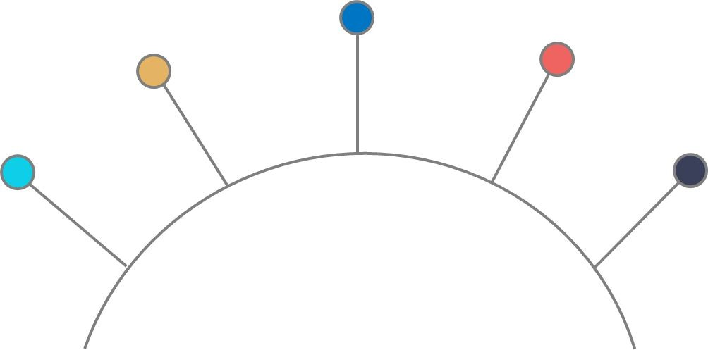
Chaincode Lifecycle
Installation
Package
Approval
Commit
Development
Chaincode lifecycle involves these steps

Slide 5


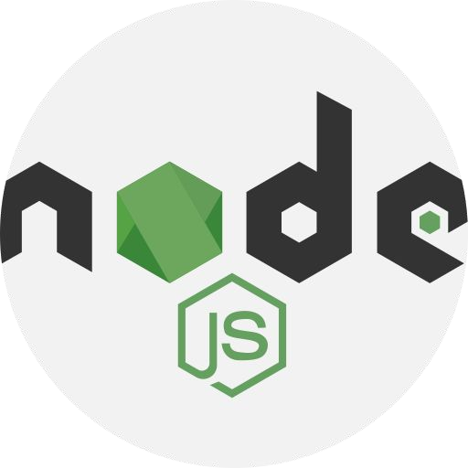
Chaincode Development
Step 1:
Chaincode can be developed using different programming languages.
Golang
Java
Nodejs

Slide 6

Chaincode Package
Chaincode package is one of the prerequisites for installing Chaincode on Fabric nodes
Step 2
organization-1
organization-2
peer1
peer2
peer1
peer2
package label: Property_1
package label: Property_1

Slide 7
Chaincode Packaging
organization-1
Chaincode may be packaged by a single organization or by all organizations
This ensures that all the peers have the same Chaincode running. Package extension is .tar.gz.
The Chaincode package contains Chaincode files and another JSON file containing metadata.
{"Path":"../Chaincode/hometransfer/build/install/hometransfe r","Type":"java","Label":“property_1"}
peer1
peer2
package label: Property_1

Slide 8
Chaincode Installation
Step 3
The Chaincode package is installed on the peers
organization-1
organization-2
peer1
peer2
peer1
peer2
package ID: Property_1: hash
package ID: Property_1: hash
package ID: Property_1: hash
package ID: Property_1: hash

Slide 9
Chaincode Installation
organization-1
Each organization's peer Admin installs the package on peers.
It is up to the organization to choose whether to install the package or not.
Package identifier is received as a response of successful package installation.
The package label and hash are used for the package identifier.
peer1
peer2
package ID: Property_1: hash
package ID: Property_1: hash

Slide 10
Approve Chaincode Definition
Before using Chaincode on the channel, the majority of organizations must agree on it.
Step 4
Package Version
Endorsement Policy
Package Identifier
Name
Sequence

Slide 11
Approve Chaincode Definition
organization-1
organization-2
Each organization must approve the Chaincode definition
Only approved Chaincode definition will be committed to the next step
End policy varies as number of organizations increases
All of these requirements are specified in the end policies
Chaincode Definition Name: Property, version:1, End Policy: (2 of 2), seq 1 Package ID: property_1:hash
peer1 peer2
Chaincode Definition Name: Property, version:1, End Policy: (2 of 2), seq 1 Package ID: property_1:hash
peer1 peer2
package ID: Property_1: hash
package ID: Property_1: hash
package ID: Property_1: hash
package ID: Property_1: hash

Slide 12
Commit Chaincode Definition
One of the admins of organization (1 or 2) commits the Chaincode definition to the channel.
Step 5
organization-1
organization-2
Chaincode Definition Name: Property, version:1, End Policy: (2 of 2), seq 1 Package ID: property_1:hash
peer1 peer2
Chaincode Definition Name: Property, version:1, End Policy: (2 of 2), seq 1 Package ID: property_1:hash
peer1 peer2
Chaincode Definition
Name: Property, version:1, End Policy: (2 of 2), seq 1
Channel
package ID: Property_1: hash
package ID: Property_1: hash
package ID: Property_1: hash
package ID: Property_1: hash

Slide 13
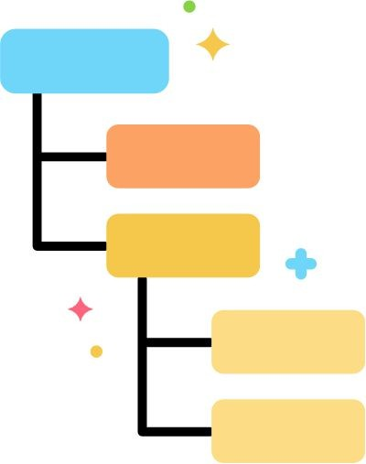



Build Automation
Build automation is the process to automate the various tasks involved in application build.
Compiling code
Adding dependencies
Deploying
Packaging code
Running tests

Slide 14





Build Automation Tools
The main build automation tools available are:
Apache Ant
Apache Maven
Gradle
Gulp

Slide 15



Build Automation History
Apache Ant was a big hit, making build automation easier for developers.
2000
Apache Maven introduced further enhancements and was a popular build automation tool.
2004
Gradle introduced a lot of new features.
2012

Slide 16


Drawbacks of Apache Ant
XML was used to write the scripts
Complex IDE integration
No support of Multi-project build
Not flexible
Hierarchical framework

Slide 17
Drawbacks of Apache Maven
Customization is difficult due to the limited number of the parameters available
Since no build cache is used, it is slower than Gradle
Built on XML
Not possible to handle several versions of the same library

Slide 18

Gradle Introduction
Gradle is a multi-language flexible software development build automation platform. It manages the entire production cycle, from compilation and packaging to testing, deployment, and release.

Slide 19


Features of Gradle
Scalability
Multi-project structure support
Gradle support dependency
Maintenance is simple
Performance is better
Customization is supported

Slide 20
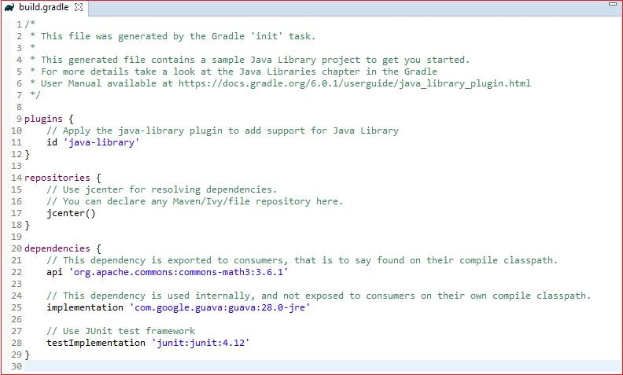
Build.gradle File
The gradle build script is known as Build.gradle
It is one of the most important files in a Gradle project and primarily consists of plugins, repositories, and dependencies

Slide 21



Build.gradle: Plugins
Java
This section of the build.gradle file adds the project's necessary Java plugins and also supports various language plugins.
Examples:
id 'checkstyle'
// To add support for Java Library, use the java-library plugin
id 'java-library-distribution'
Groovy
Scala
Antlr

Slide 22


Build.gradle: Repositories
This section of the build.gradle file allows adding appropriate repositories, which can be internal or external. These repositories aid in dependencies.
Example:
maven {
url "https://hyperledger.jfrog.io/hyperledger/fabric-maven"
}
jcenter() maven {
url 'https://jitpack.io'
}
Apache Ant
Apache Maven
Apache Ivy

Slide 23



Build.gradle: Dependencies
Project Development
This section of the build.gradle file allows adding appropriate dependencies to fast track tasks in development lifecycle
Examples:
Compile only
'org.hyperledger.fabric-Chaincode-java:fabric-Chaincode-shim:2.2.
+'
implementation
'com.owlike:genson:1.5‘
Code Compilation
Deployment

Slide 24
Fabric Chaincode API
Fabric offers the Chaincode API, which developers can use to create smart contracts. This primarily consists of the three packages mentioned herein:
Provides interfaces and classes to support the contract programming model
org.hyperledger.fabric.contract:
Provides annotations required for Contract implementations
org.hyperledger.fabric.contract.annotation:
Provides interfaces and classes required for chaincode development and state variable access
org.hyperledger.fabric.shim:
Reference: https://hyperledger.github.io/fabric-chaincode-java/release-2.2/api/index.html

Slide 25
Contract Package
The Contract package contains the necessary interface and classes for Chaincode development in Fabric.
Contract Package
Interface
Class
ContractInterface
Context
ClientIdentity

Slide 26
Contract Package: Interface
The ContractInterface is one of the most essential interfaces that every Chaincode must implement.
Any contract transaction's sequence will be followed by these actions:
createContext() -> beforeTransaction() -> the transaction function -> afterTransaction()
Modifier and Type | Method | Description
default void | afterTransaction(Context ctx, java.lang.Object result) | Invoked once after each transaction
default void | beforeTransaction(Context ctx) | Invoked once before each transaction
default Context | createContext(ChaincodeStub stub) | Create context from ChaincodeStub
default void | unknownTransaction(Context ctx) | Invoked for any transaction that does not exist
:https://hyperledger.github.io/fabric-chaincode-java/release-2.2/api/org/hyperledger/fabric/contract/ContractInterface.html

Slide 27
Contract Package: Interface
afterTransaction() is invoked once after each transaction. The parameters of this function are:
Syntax: default void afterTransaction(Context ctx, java.lang.Object result)
Input: ctx– Context instance and object returned from transaction function
Output: It does not return anything

Slide 28
Contract Package: Interface
beforeTransaction() is invoked once before each transaction. The parameters of this function are:
Syntax: default void beforeTransaction(Context ctx)
Input: ctx– Context instance
Output: It does not return anything

Slide 29
Contract Package: Interface
When a transaction begins, the first function that is called is createContext(). The parameters of this function are:
Syntax: default Context createContext(ChaincodeStub stub)
Input: stub – ChaincodeStub instance
Output: It returns the context instance to use for current transaction

Slide 30
Contract Package: Interface
unknownTransaction() is invoked for the transaction that does not exist. The parameters of this function are:
Syntax: default void unknownTransaction(Context ctx)
Input: ctx– Context instance
Output: It does not return anything, rather throws the exception

Slide 31
Contract Package: Class
Context is one of most important classes that every Chaincode needs to use as it provides the transaction context.
This provides an API to read the current state by adding getStub().
If an application wants to add features, it can build its own version.
All subclasses MUST
implement a constructor.
Example:
public SampleContext extends Context
{
public SampleContext(ChaincodeStub stub)
{
super(stub);
}
}

Slide 32
Shim Package
Shim package contains all the necessary interfaces, classes, and exceptions for Chaincode development in Fabric.
Shim Package
Interface
Class
Exception
Chaincode
ChaincodeStub
ChaincodeBase
ChaincodeException

Slide 33
Shim Package: Interface
Chaincode is one of the shim interfaces that every Chaincode must implement.
Modifier and Type | Method | Description
Chaincode.Response | init(ChaincodeStub stub) | After the container has been created, this method is called during an instantiated transaction to allow the chaincode to initialize its internal data
Chaincode.Response | invoke(ChaincodeStub stub) | Called for every function call
_{Po}R_{w}e_{e}f_{r}e_{e}r_{d}e_{b}n_{y}ce: https://hyperledger.github.io/fabric-chaincode-java/main/api/org/hyperledger/fabric/shim/Chaincode.html

Slide 34
Shim Package: Interface
ChaincodeStub is a shim interface for managing transaction context and accessing state variables.
Method | Description
getState(java.lang.String key) | Return the value stored in the ledger for given key
putState(java.lang.String key, byte[ ] value) | Write key and value to a ledger
invokeChaincode(java.lang.String ChaincodeName, java.util.List<byte[ ]> args) | Invoke another Chaincode with the same transaction context
Reference: https://hyperledger.github.io/fabric-chaincode-java/main/api/org/hyperledger/fabric/shim/ChaincodeStub.html

Slide 35
Shim Package: Exception
One of the shim exceptions that developers use to create and throw exceptions is
ChaincodeException. It has eight constructors, each of which accepts a different set of arguments.
Constructor | Description
ChaincodeException(java.lang.String message) | Constructor with error message
ChaincodeException(java.lang.String message, java.lang.Throwable cause) | Constructor with error message and cause
ChaincodeException(java.lang.String message, java.lang.String payload, java.lang.Throwable cause) | Constructor with error message, response payload, and cause

Slide 36
Annotation Package
Annotation package helps to annotate and provide details about contract, properties, and datatypes.
Annotation Package
Contract
Datatype
Property
Transaction

Slide 37
Annotation Package: Contract
Annotation at the Chaincode level provides a clear and meaningful name for Chaincode while also providing specific details about the contract's functionality
Example:
@Contract(
name = "HomeTransfer", info = @Info(
title = "HomeTransfer contract",
description = "A Sample home transfer Chaincode example", version = "0.0.1-SNAPSHOT"))

Slide 38
Annotation Package: Datatype
This indicates that the class is one of the data types that can be passed to or returned from any transaction function
Example:
@DataType()
public final class Home {
}

Slide 39
Annotation Package: Property
This property annotation is used for fields and parameters which are further used in transaction functions
Example:
@Property()
private final String name; @Property()
private final String id; @Property()
private final String area;

Slide 40
Annotation Package: Transaction
This transaction annotation is used for chaincode functions.
These functions are called
in client SDKs
Example:
/**
Add some initial properties to the ledger
*
@param ctx the transaction context
*/ @Transaction()
public void initLedger(final Context ctx) { }

Slide 41



Use Case
Car Id
Model Owner Value
Car Showroom Dealer
Buyer

Slide 42
Chaincode Functions
Add New Car: This function enables a dealer to introduce a new car to his showroom and add information about it to the blockchain.
Query Car By ID: By entering the car ID as input, this function aids in querying the car information and checking the car owner.
Transfer Car Ownership: This function is used by the dealer to transfer the ownership of the car to the buyer.

Slide 43
Chaincode Development High-Level Steps
1
Set up tools for Chaincode development
2
Develop Chaincode
3
Compile Chaincode

Slide 44


Set up Tools for Chaincode Development
Java JDK 8
Eclipse Installation
Gradle Installation
Link Gradle to Eclipse

Slide 45

Java Setup
sudo apt update
sudo apt install openjdk-8-jdk
Install JDK
Verify Installation
1. java --version

Slide 46
Gradle Setup
https://gradle.org/releases/
Define GRADLE_HOME variable
Update PATH variable
Install Gradle
Verify Installation
1. gradle --version

Slide 47
Eclipse/Installation (Vscode)
Install Eclipse
https://www.eclipse.org/downloads/packages/installer

Slide 48
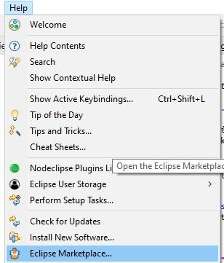
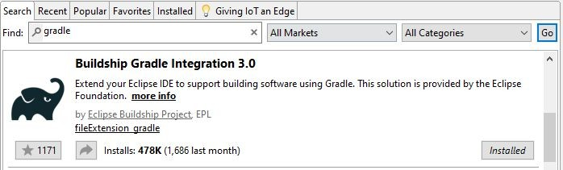
Link Gradle with Eclipse/Vscode
The Latest version of Eclipse includes a pre-installed Gradle extension.
Add Gradle extension using Eclipse Marketplace for the older versions of Eclipse.

Slide 49
Assisted Practice: Guidelines
Steps to set up development prerequisites:
Installing JDK 8
Installing Eclipse IDE
Installing Gradle
Linking Gradle with the Eclipse IDE

Slide 50
Chaincode Development
Chaincode development involves steps:
Create Gradle Project
Create new project
Import dependencies
Create Car Asset Object
Import required packages
Create required variables
Create constructor
Create Car Contract
Create Contract
Create Init function
Add all other functions

Slide 51
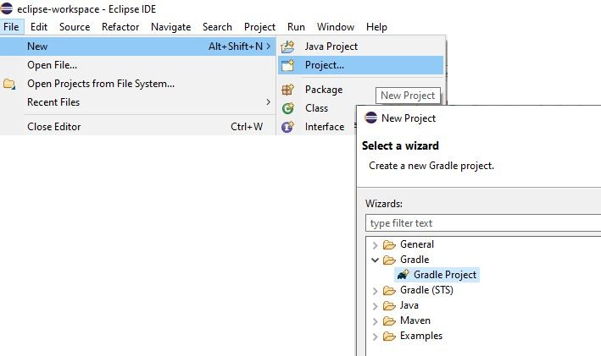
Gradle Project: Create New Project
1. Create new gradle project using required naming conventions

Slide 52
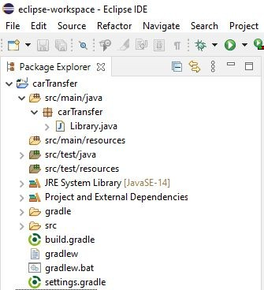
Gradle Project: Folder Structure
src/main/java: Contains java files
src/main/resources: Contains java reference files
gradle: gradle libraries
build.gradle: Gradle build file

Slide 53
Gradle project: Import Dependencies
Fabric dependency: Helps to refer to fabric functions
org.hyperledger.fabric-Chaincode-java:fabric-Chaincode-shim:2.2.+
JSON dependency: Converts to JSON
com.owlike:genson:1.5
Math dependency: Includes math functions
org.apache.commons:commons-math3:3.6.1

Slide 54
Car Asset Object: Import Required Packages
Step 1: Import required packages
Package carShowroom
import com.owlike.genson.annotation.JsonCar;
import org.hyperledger.fabric.contract.annotation.DataType; import org.hyperledger.fabric.contract.annotation.Property; import java.util.Objects;
@DataType()
public final class car{
}

Slide 55
Car Asset Object: Create Required Variables
Step 2: Define variables
@Property()
private final String id; @ Property()
private final String model; @Property()
private final String owner; @Property()
private final String value; public String getId() {
return id; }
public String getModel() { return name; }
public String getOwner() { return owner; }
public String getValue() { return value; }

Slide 56
Car Asset Object: Create Constructor
Step 3: Define constructor
public Car(@JsonCar("id") final String id, @JsonCar(“model") final String model, @JsonCar("owner") final String owner, @JsonCar("value") final String value) {
this.id = id;
this.model | = | model;
this.owner | = | owner;
this.value | = | value;
}

Slide 57
Car Contract: Create Contract
Step 1: Create contract
package CarShowroom
import org.hyperledger.fabric.contract.Context;
import org.hyperledger.fabric.contract.ContractInterface;
import com.owlike.genson.Genson; @Default
public final class CarShowroom implements ContractInterface { @Contract(
name = “CarShowroom", info = @Info(
title = “CarShowroom contract",
description = "A Sample Car transfer Chaincode example", version = "0.0.1-SNAPSHOT"))
}

Slide 58
Car Contract: Create init Function
Step 2: Create init function
@Transaction()
public void initLedger(final Context ctx) { ChaincodeStub stub= ctx.getStub();
Car car= new Car("1", “Maruti“,"Mark","6756"); String carState = genson.serialize(car); stub.putStringState("1", carState);
}

Slide 59
Car Contract: Create Other Functions
Step 3: Create other functions
@Transaction()
public Car addNewCar(final Context ctx, final String id, final String model,final String ownername, final String value) {
ChaincodeStub stub = ctx.getStub();
String carState = stub.getStringState(id); if (!carState.isEmpty()) {
String errorMessage = String.format(“Car %s already exists", id); System.out.println(errorMessage);
throw new ChaincodeException(errorMessage, Car ShowroomErrors.CAR.ALREADY.EXISTS.toString());}
Car car = new Car(id, model, ownername,value); carState = genson.serialize(car); stub.putStringState(id, carState);
return car;
}

Slide 60
Car Contract: Create Other Functions
Step 3: Create other functions (continued)
@Transaction()
public Car queryCarById(final Context ctx, final String id) { ChaincodeStub stub = ctx.getStub();
String CarState = stub.getStringState(id);
if (CarState.isEmpty()) {
String errorMessage = String.format("Car %s does not exist", id); System.out.println(errorMessage);
throw new ChaincodeException(errorMessage, CarShowroomErrors.Car.NOT.FOUND.toString());
}
Car Car = genson.deserialize(CarState, Car.class); return Car;
}

Slide 61
Chaincode Compilation
Chaincode compilation guarantees that the Chaincode is free of syntax errors and generates a jar file containing all Chaincode files
Command to compile the Chaincode:
./gradlew installDist

Slide 62
Assisted Practice: Guidelines
Steps to create chaincode for car showroom:
Creating Car.java file
Creating CarTransfer.java file
Compiling the chaincode in the terminal

Slide 63
Package Chaincode
Create a Chaincode package and save it to a file
peer lifecycle chaincode package [outputfile] [flags]
Example:
peer lifecycle chaincode package carshowroom.tar.gz --path
../chaincode/carshowroom/build/install/carshowroom --lang java –label carshowroom_1

Slide 64
Assisted Practice: Guidelines
Steps to package the chaincode:
Setting up the Hyperledger Fabric Test network
Packaging the carshowroom chaincode

Slide 65
Install Chaincode
On peers, install the Chaincode package
peer lifecycle Chaincode install [flags]
Example:
peer lifecycle Chaincode install carshowroom.tar.gz --peerAddresses peer0.org1.example.com:7051

Slide 66
Query Installed Chaincode
Query the package Id and label
peer lifecycle Chaincode queryinstalled [flags]
Get an installed Chaincode package from a peer
peer lifecycle Chaincode getinstalledpackage [outputfile] [flags]

Slide 67
Assisted Practice: Guidelines
Steps to install the chaincode:
Installing chaincode on Org1 and Org2
Querying the installed chaincode on Org1 and Org2
Downloading the installed chaincode from the Org1

Slide 68
Approve Chaincode Definition
Approve the Chaincode definition for my organization
peer lifecycle Chaincode approveformyorg [flags]
Example:
peer lifecycle Chaincode approveformyorg -o localhost:7050 --ordererTLSHostnameOverride orderer.example.com --tls --cafile $ORDERER_CA --channelID samplechannel --name CarShowroom
--version 1.0 --init-required --package-id carshowroom_1:21eca37f8b0d091d94ac7c310cd52b6bf2a1401837aa0fb99b90a73f76d4c083
--sequence 1

Slide 69
Assisted Practice: Guidelines
Steps to approve the chaincode:
Approving chaincode for Org1
Approving chaincode for Org2

Slide 70
Commit Chaincode Definition
Check whether a Chaincode definition is ready to be committed on a channel
peer lifecycle Chaincode checkcommitreadiness [flags]
Example:
peer lifecycle Chaincode checkcommitreadiness --channelID samplechannel --name car
--version 1.0 --sequence 1 --output json --init-required

Slide 71
Commit Chaincode Definition
Commit the Chaincode definition on the channel
peer lifecycle Chaincode commit [flags]
Example:
peer lifecycle Chaincode commit -o localhost:7050 --ordererTLSHostnameOverride orderer.example.com
--tls $CORE_PEER_TLS_ENABLED --cafile $ORDERER_CA --channelID samplechannel --name CarShowroom
--peerAddresses localhost:7051 --tlsRootCertFiles $CORE_PEER_TLS_ROOTCERT_FILE_ORG1
--peerAddresses localhost:9051 --tlsRootCertFiles $CORE_PEER_TLS_ROOTCERT_FILE_ORG2 --version 1.0
--sequence 1 --init-required

Slide 72
Commit Chaincode Definition
Query the committed Chaincode definitions by channel on a peer
peer lifecycle Chaincode querycommitted [flags]
Example:
peer lifecycle Chaincode querycommitted --channelID samplechannel --name car

Slide 73
Assisted Practice: Guidelines
Steps to commit the chaincode:
Checking commit readiness for Org1 and Org2
Committing the chaincode definition to samplechannel
Querying the committed chaincode from samplechannel

Slide 74
Initialize the Chaincode
Init function is the very first function that needs to be called to initialize the Chaincode before we call other custom functions
peer Chaincode invoke -o localhost:7050 --ordererTLSHostnameOverride orderer.example.com --tls
$CORE_PEER_TLS_ENABLED --cafile $ORDERER_CA -C samplechannel -n CarShowroom --peerAddresses localhost:7051 --tlsRootCertFiles $CORE_PEER_TLS_ROOTCERT_FILE_ORG1 --peerAddresses localhost:9051
--tlsRootCertFiles $CORE_PEER_TLS_ROOTCERT_FILE_ORG2 --isInit -c '{"Args":[]}'

Slide 75
Access Chaincode functions
Invoke command helps to call custom functions developed in Chaincode
peer Chaincode invoke -o localhost:7050 --ordererTLSHostnameOverride orderer.example.com --tls
$CORE_PEER_TLS_ENABLED --cafile $ORDERER_CA -C samplechannel -n CarShowroom --peerAddresses localhost:7051 --tlsRootCertFiles $CORE_PEER_TLS_ROOTCERT_FILE_ORG1 --peerAddresses localhost:9051
--tlsRootCertFiles $CORE_PEER_TLS_ROOTCERT_FILE_ORG2 -c '{"Args":["addNewCar", "2", “Ford“,"John","1000"]}'

Slide 76
Steps for execution of chaincode
C:\Users\ACER\Desktop\StudyMaterial\Hyperledger Fabric\1.set_up_development_prerequisites.docx
C:\Users\ACER\Desktop\StudyMaterial\Hyperledger Fabric\2.set_up_hyperledger_fabric_prerequisites.docx
C:\Users\ACER\Desktop\StudyMaterial\Hyperledger Fabric\3.set_up_hyperledger_fabric.docx
C:\Users\ACER\Desktop\StudyMaterial\Hyperledger Fabric\4.set_up_hyperledger_test_networ.docx
C:\Users\ACER\Desktop\StudyMaterial\Hyperledger Fabric\5.create_a_gradle_project_for_carshowroom.docx

Slide 77
Steps for execution of chaincode continue..
C:\Users\ACER\Desktop\StudyMaterial\Hyperledger Fabric\6.create_chaincode_for_carshowroom.docx
C:\Users\ACER\Desktop\StudyMaterial\Hyperledger Fabric\7.package_the_chaincode.docx
C:\Users\ACER\Desktop\StudyMaterial\Hyperledger Fabric\8.install_the_chaincode.docx
C:\Users\ACER\Desktop\StudyMaterial\Hyperledger Fabric\9.approve_the_chaincode.docx
C:\Users\ACER\Desktop\StudyMaterial\Hyperledger Fabric\10.commit_the_chaincode.docx
C:\Users\ACER\Desktop\StudyMaterial\Hyperledger Fabric\11.access_chaincode_functions.docx

